Slide 1
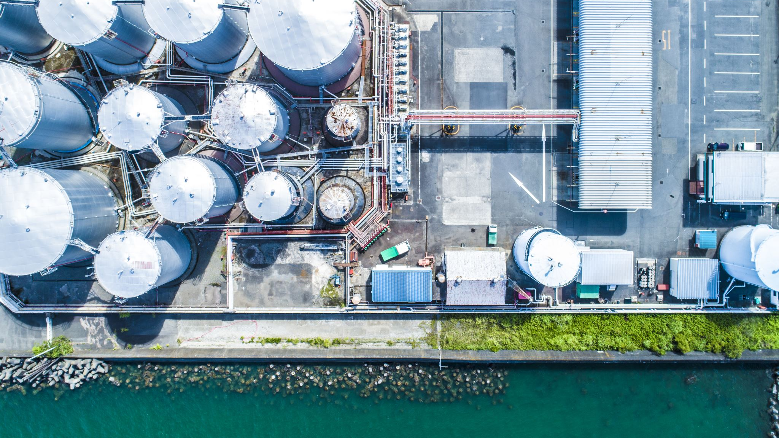
Catalysts
Rates of reactions

Slide 2
Outline
Review Collision theory – 3 points
Factors effecting rate of reaction:
Concentration
Pressure
Surface area
Temperature
Catalysts

Slide 3
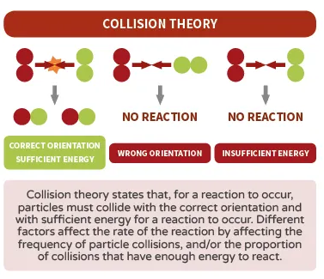
Collision Theory
The way in which reactions occur can be understood in terms of collision theory
The reacting particles must collide
The particles must collide with enough energy to equal or exceed a certain amount (activation energy Ea)
Reacting particles must collide in a suitable orientation
All three of these must occur for a reaction to proceed

Slide 4
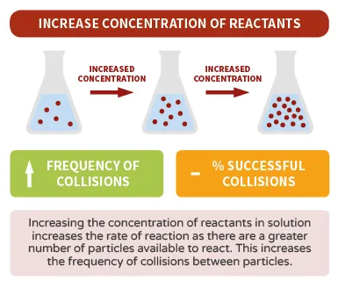
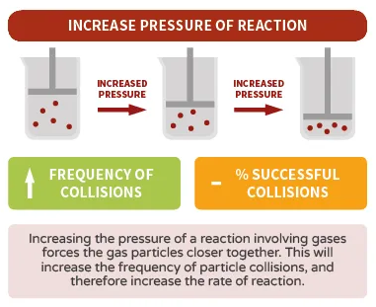
Factors effecting rate of reaction
Key Questions:
Change the frequency of collisions?
Change the frequency of successful collisions?

Slide 5
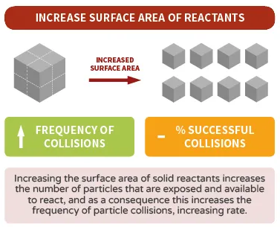
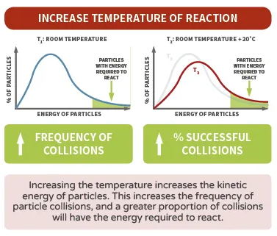
Factors effecting rate of reaction
Key Questions:
Change the frequency of collisions?
Change the frequency of successful collisions?

Slide 6
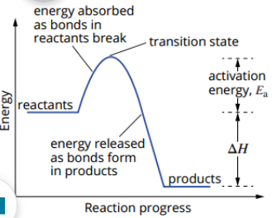
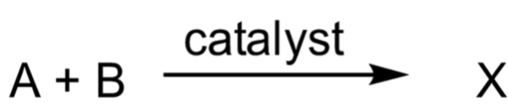
Catalysts
Activation energy (Ea) is the minimum energy required for a reaction to take place
Catalysts are not consumed in the reaction (**So, we don’t write them in the equation. We write them above the reaction arrow**)

Slide 7
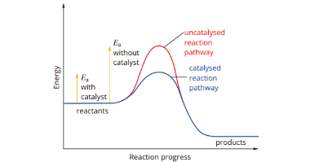
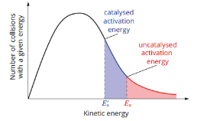
Catalysts
A catalysts increasing the rate of reaction by providing an alternative pathway for the reaction
The alternative path has a lower activation energy, so more particles now have sufficient kinetic energy to achieve a successful collision

Slide 8
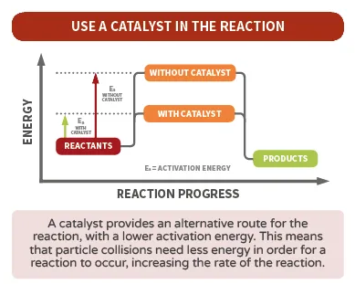
Catalysts
Remember
Catalyst is not consumed in the reaction
We write the catalyst above the reaction arrow

Slide 9
Catalysts
Examples of catalysts
Inorganic catalysts – e.g. many transition metals and compounds containing transition metals are good catalysts
The synthesis of ammonia (NH₃) from nitrogen gas (N₂) and hydrogen gas (H₂)
No catalyst – activation energy = 238.5 kJ/mol
With Catalyst – activation energy = 50.2 kJ/mol (used an iron catalysts)

Slide 10
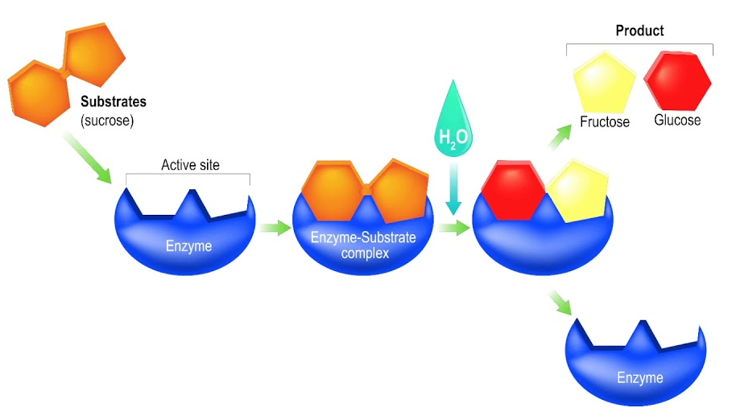
Catalysts
Examples of catalysts
Biological catalysts – enzymes catalyse many processing in living systems. These complex molecules have 3-dimensional structures that allow it to selective interact with specific substrates. Enzymes decrease Ea and direct the orientation of substrates.
Called the “LOCK and KEY” model

Slide 11
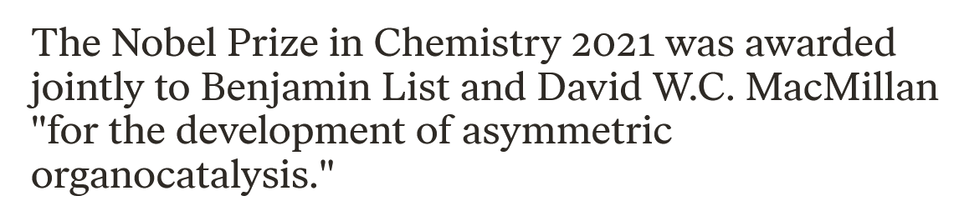
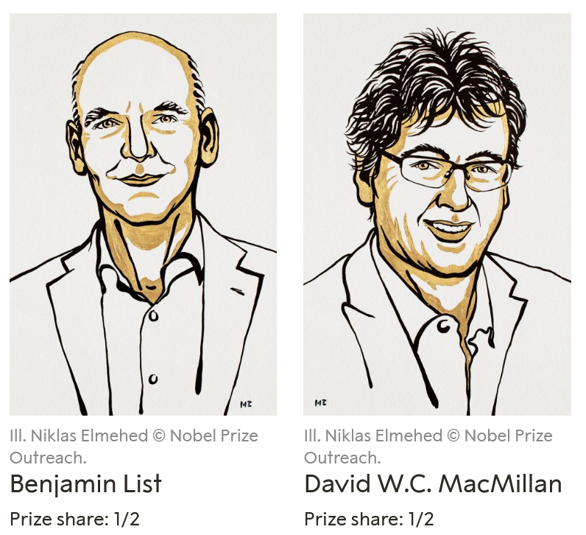
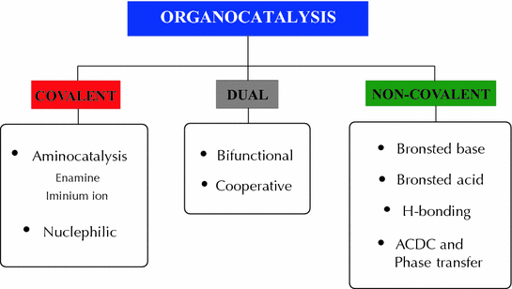
2021 Noble prize in Chemistry

Slide 12
On going work
Pearson chapter 19
STAWA Set 39 Rates of reaction
Great videos:
Measuring the rate of reaction: https://www.youtube.com/watch?v=GCR5xeduq2o
Rates of reaction – factors https://www.youtube.com/watch?v=SPXanyy3-hU https://www.youtube.com/watch?v=-4HXaUBbv04

Slide 13
Outline

